Slide 1


Titolo presentazione sottotitolo
Pricing-Advertising project
Online learning applications – Professor Nicola Gatti,
Matteo Castiglioni and Martino Bernasconi de Luca
Milano, XX mese 20XX
Arrigoni Francesca, Enrico Brunetti, Stefano Ferrara, Davide Gesualdi, Stefano Vighini

Slide 2


Step 0
We want to find an optimal pricing and advertising strategy for a backpack
Prices ∈ {10€, 20€, 30€, 40€, 50€}
Bids ∈ [ 0€, 2€ ], 100 bids
T=365 giorni
Features of the customers:
Employment
Residence
C1: students
C2: commuter workers
C3: resident workers

Slide 3
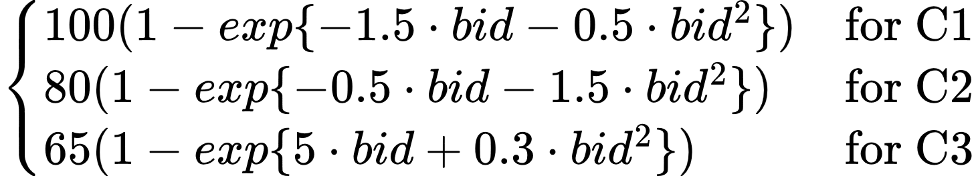
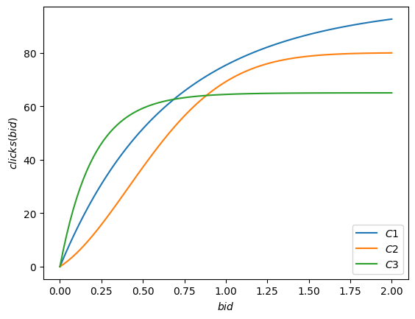
Step 0 Number of clicks

Slide 4
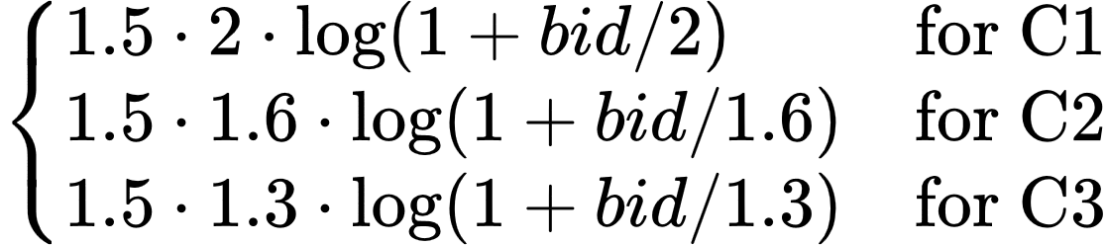
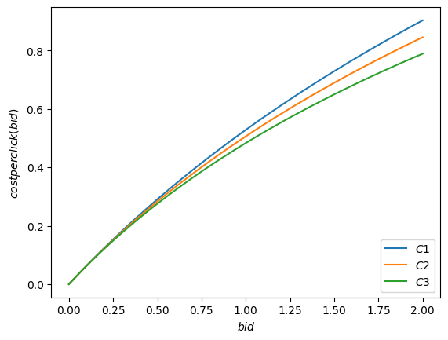
Step 0 Daily click cost

Slide 5
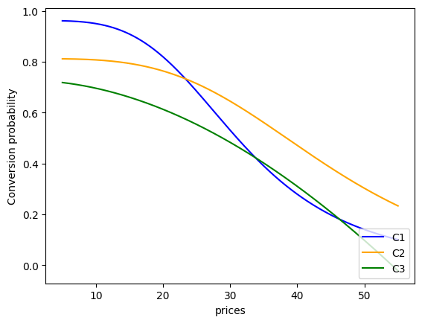
Step 0 Conversion rate

Slide 6
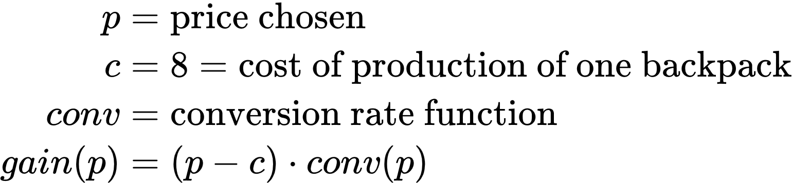
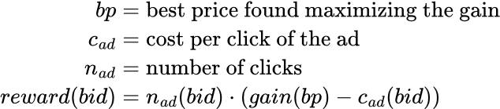
Step 0 Clairvoyant algorithm
Pricing problem:
Advertising problem:

Slide 7
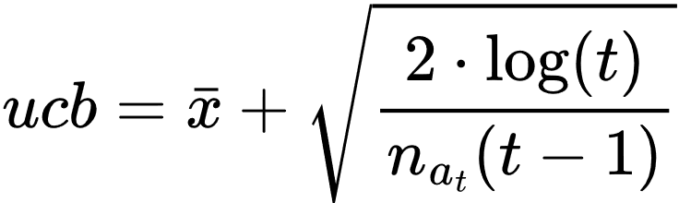
Step 1 : Pricing
All customers belong to C1
The bid is fixed at 2€ for each ad
The number of customers that enter the website each day is 92 people
We employ two different algorithm to maximise the reward:
UCB-1:
Thompson Sampling:

Slide 8
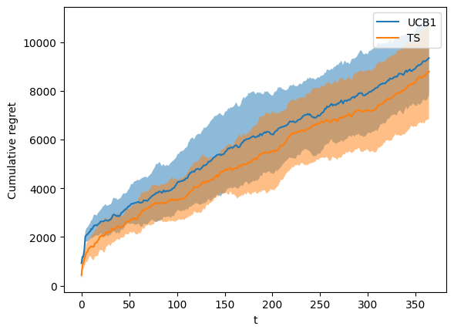
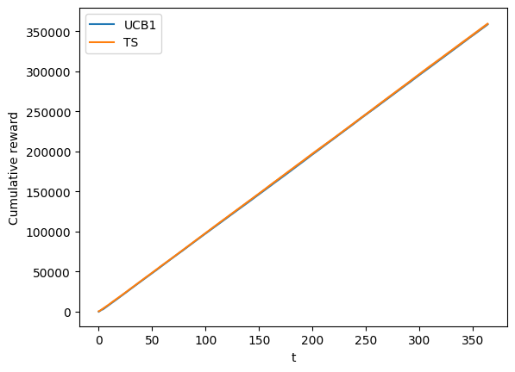
Step 1 : Results

Slide 9
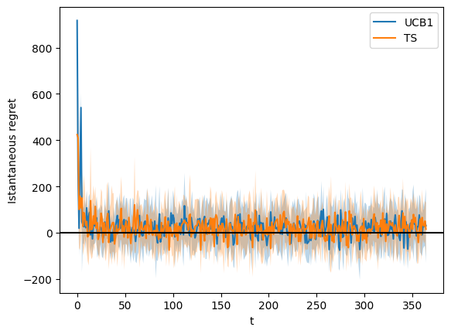
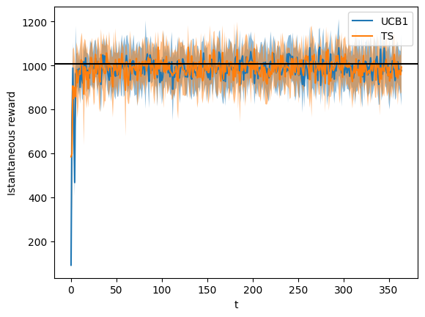
Step 1 : Results

Slide 10
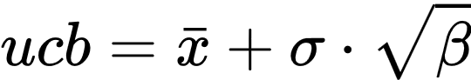
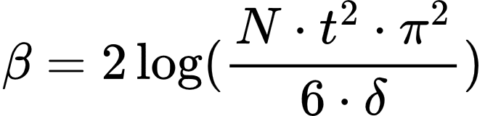
Step 2 : Advertising
All customers belong to C1
The price is fixed at 30€
We employ two Gaussian Processes algorithm to maximize the reward:
GPUCB:
GPTS: The posterior distribution of the Gaussian process is distributed as a Gaussian in which we can update the mean and standard deviation

Slide 11
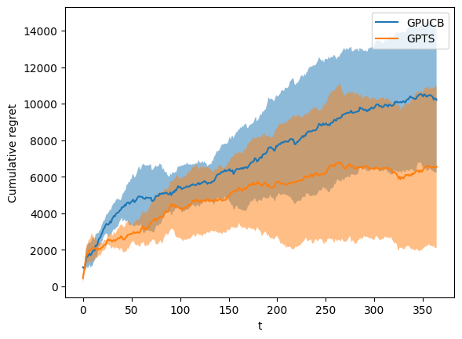
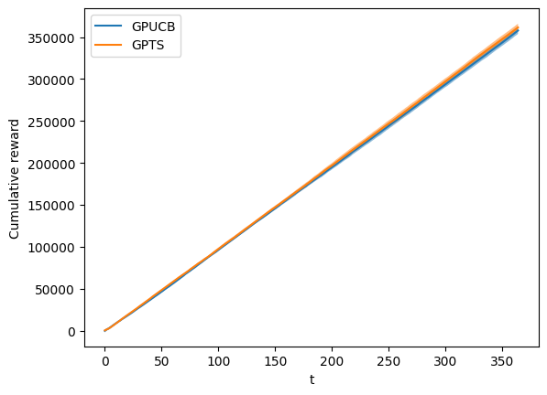
Step 2 : Results

Slide 12
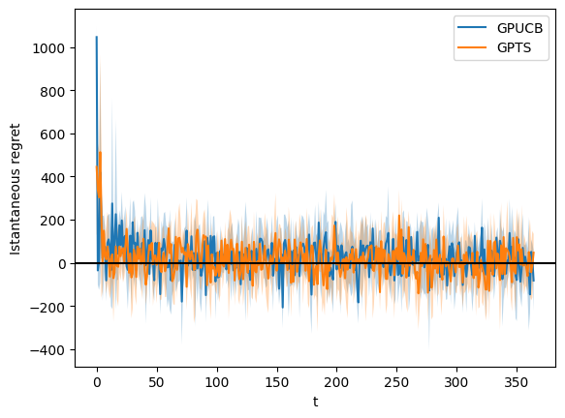
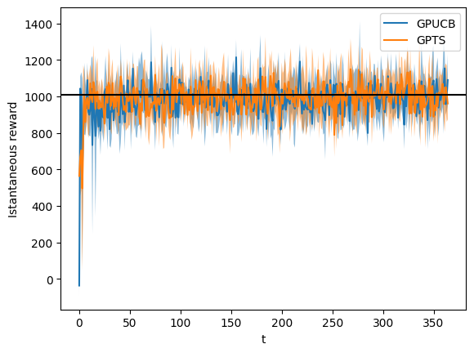
Step 2 : Results

Slide 13
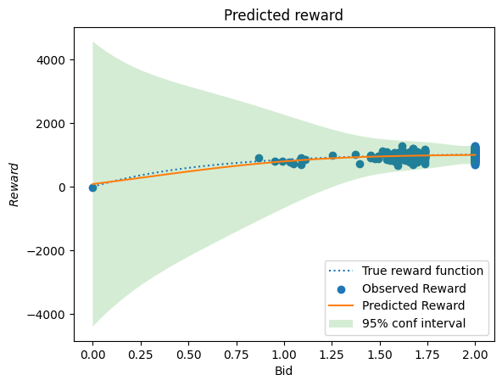
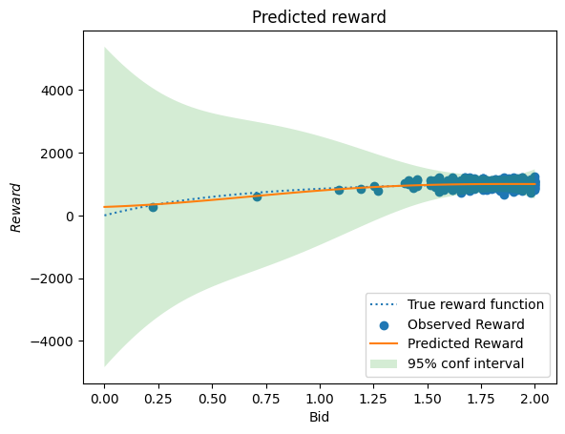
Step 2 : Results
GPUCB
GPTS

Slide 14
Step 3 : Pricing + Advertising
All customers belong to C1
We employ a single environment that first samples from the advertising curves and uses the results to sample from the pricing curve.
The algorithms employed are:
UCB-1 for the pricing part
GPUCB for the advertising part
Thompson Sampling for the pricing part
GPTS for the advertising part

Slide 15
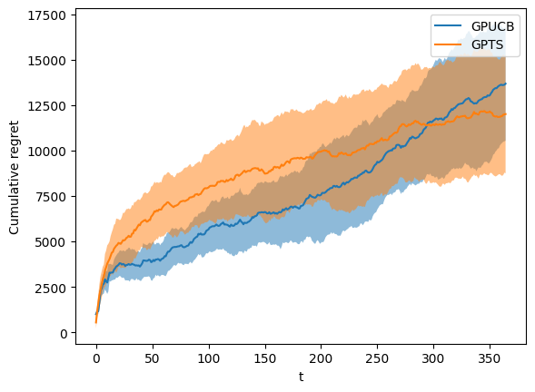
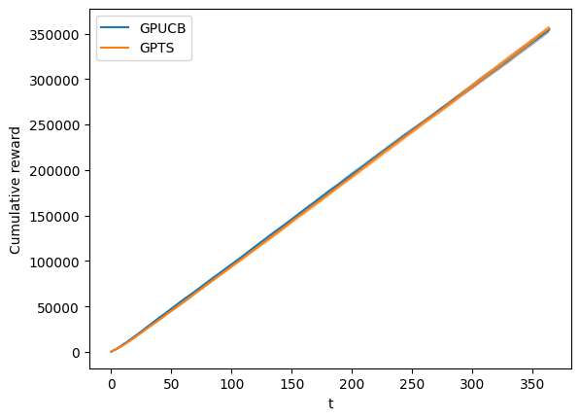
Step 3 : Results

Slide 16
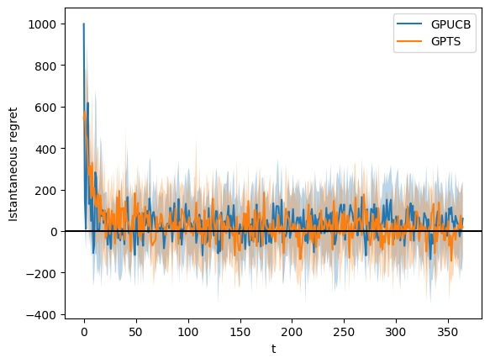
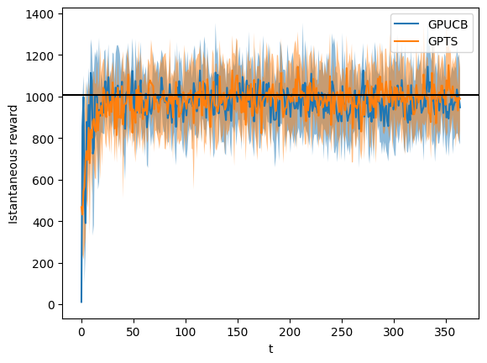
Step 3 : Results

Slide 17
Step 4 : Multiple customers
C1, C2, and C3 get pulled with the same probability every round
Pull feature first, then pull arm from a context
Analize reward in 3 scenarios:
Not using any context
Using known contexts
Generating the context (every 14 rounds)

Slide 18
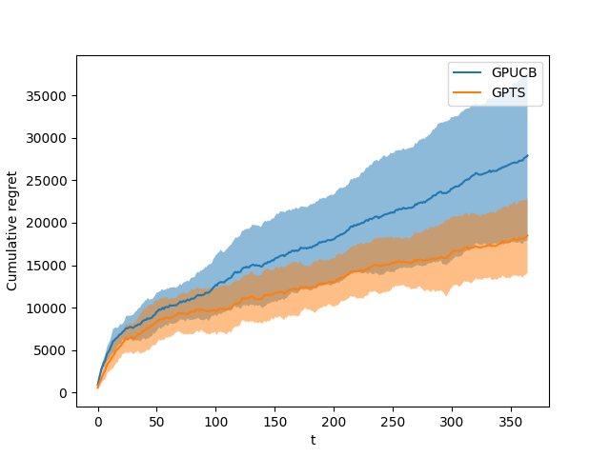
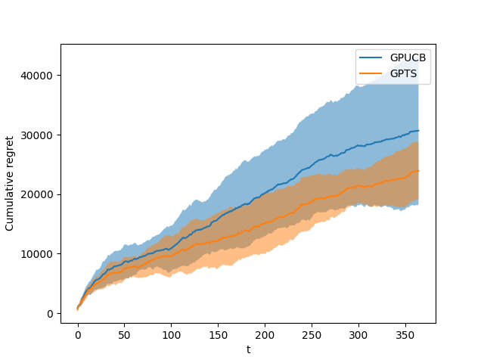
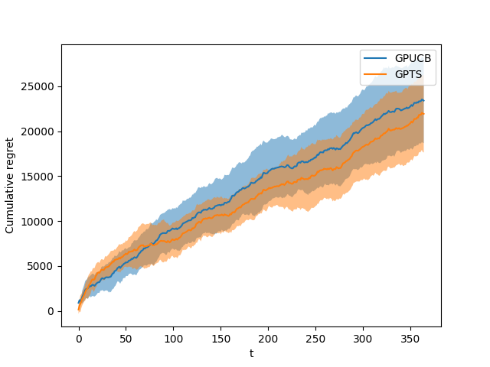
Step 4 : Results
Known Context
Generated Context
Without Context

Slide 19
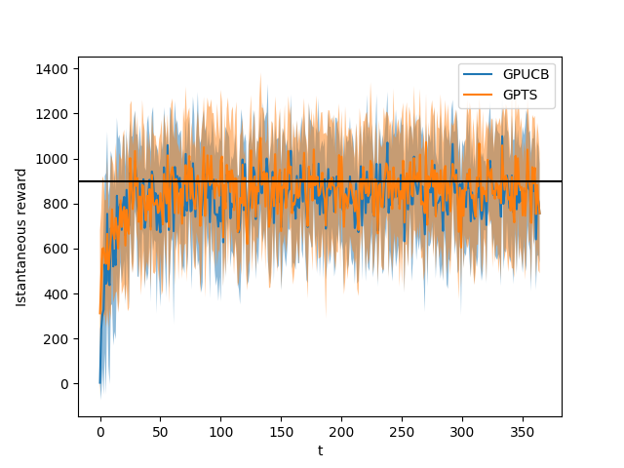
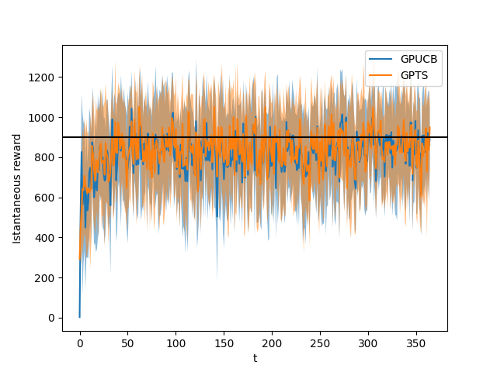
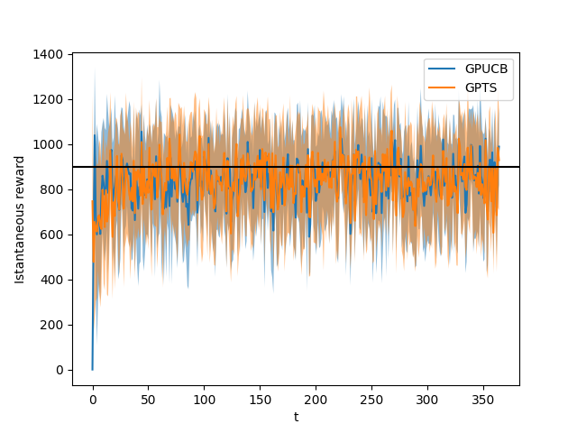
Step 4 : Results
Known Context
Generated Context
Without Context

Slide 20
Step 4 : Unexpected behaviour
Convergence speed
Reward difference between context and non context
Not applicable, too small differences (only 30 €)

Slide 21
Step 5: Setting
Non Stationary(Pricing) Environment.
All users belong to C1.
3 phases during the year:
- July to October, students buy new backpacks for the upcoming school year 🡪 higher conversion probabilities
- November to February, Christmas holidays, people tend to spend more for presents 🡪 higher conversion probabilities for more expensive prices
- March to June, regular purchasing behaviour, less need for new backpacks in general 🡪 lower conversion probabilities.

Slide 22
Step 5 : Algorithms
Stationary UCB1
Sliding Window UCB1(passive approach): employs a sliding window of fixed size to store samples, computing the upper confidence bound only over those samples
CUSUM UCB1(active approach): employs the CUSUM procedure to detect a change in the underlying distributions, dependent on four parameters(M,ε,h,α)

Slide 23
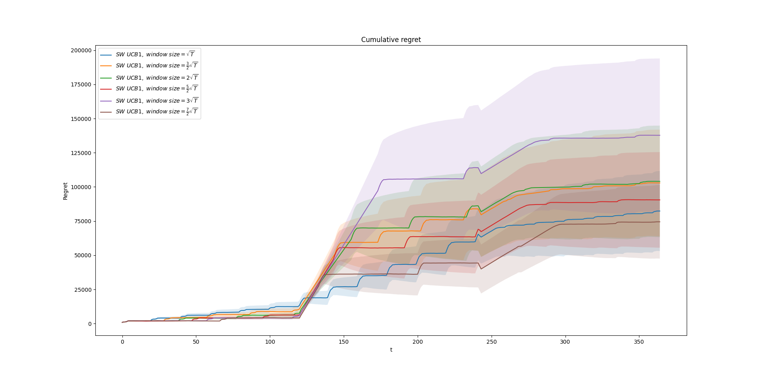
Step 5 : Sliding Window UCB1
From theory, τ ∝ √T, so we tried six different multiplying constants: 1, 1.5 , 2, 2.5 , 3 , 3.5.
larger window sizes associated to lower regret
in particular, 3.5√T is the best one

Slide 24
Step 5: CUSUM UCB1
CUSUM values for every arm representing deviation from the expected reward 🡪 when a threshold is exceeded a change is detected
4 parameters to be selected:
M, number of samples over which the mean is computed
ε, adjusting the difference between current mean and new samples
h, threshold to be surpassed in order to trigger a change
α, probability of pulling a random arm at each round

Slide 25
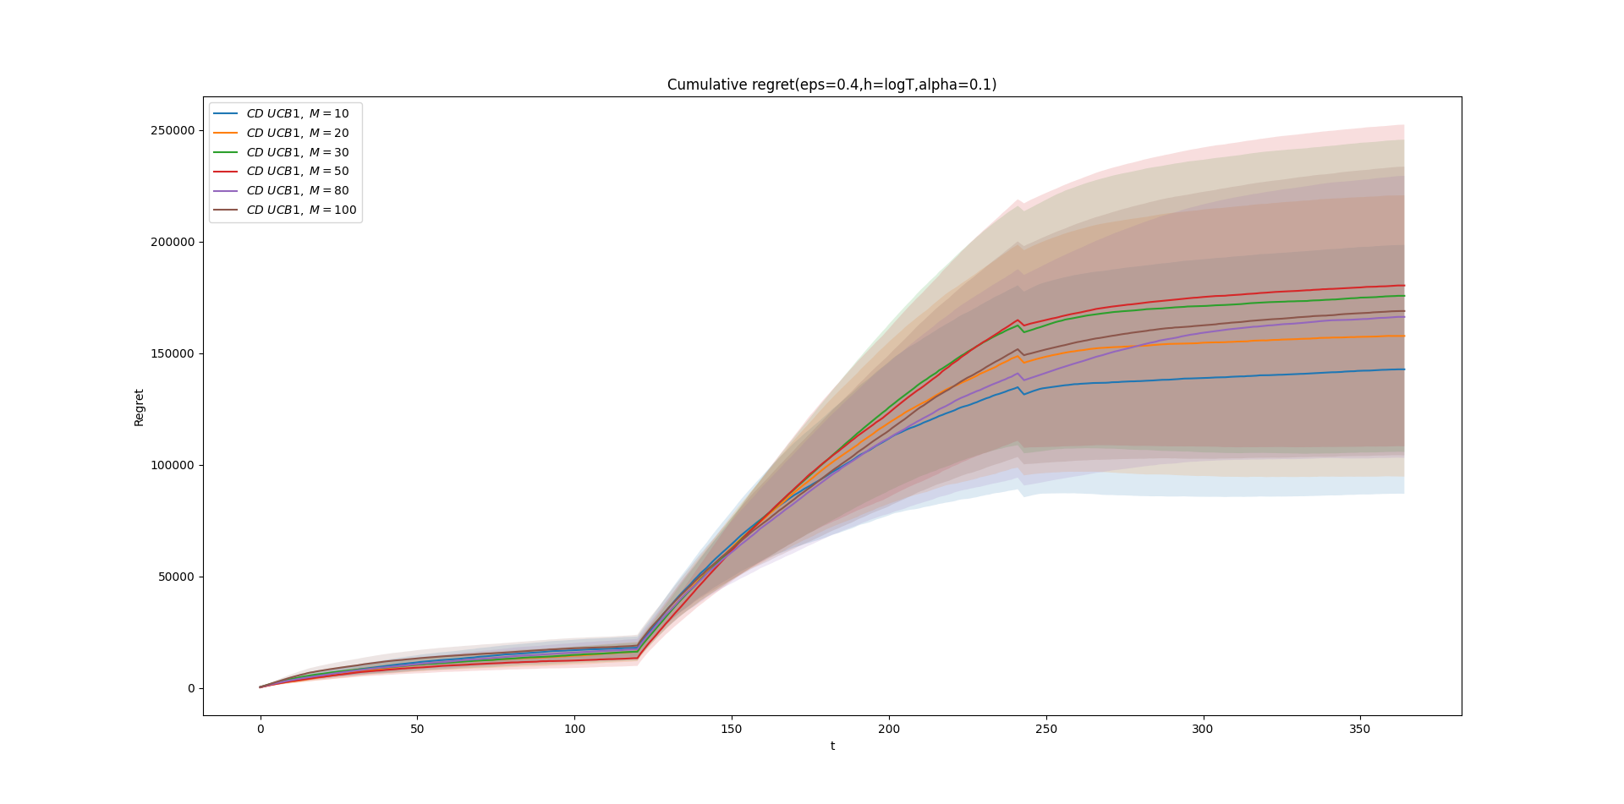
Step 5: Analysis of M
Starting from fixed values for the other parameters, we tested six possible choices for M: 10,20,30,50,80,100.
smaller window size is preferred, we set M=10.

Slide 26
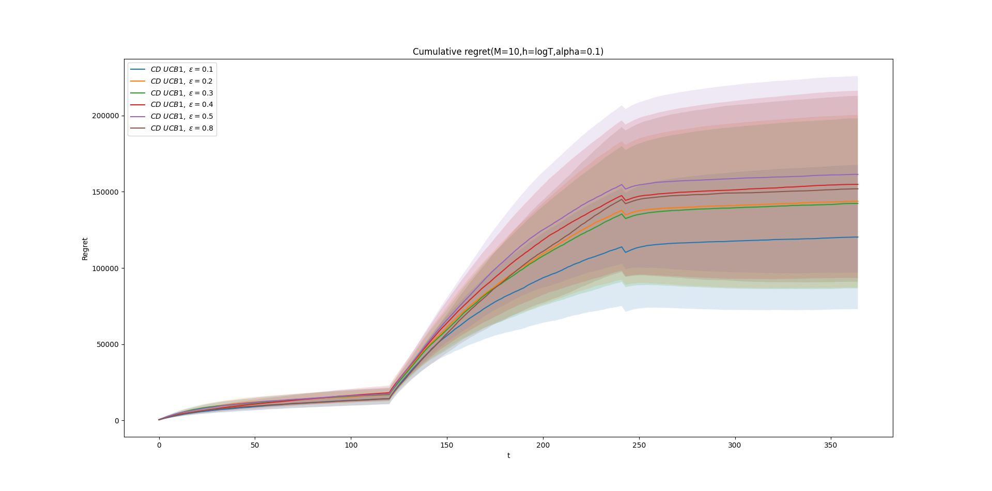
Step 5: Analysis of ε
Normalized rewards 🡪 values in [0,1]
We tested six possibilities: 0.1,0.2,0.3,0.4,0.5,0.8
no clear best value, but ε=0.1 was the most frequent among multiple runs and with biggest difference in single ones.

Slide 27
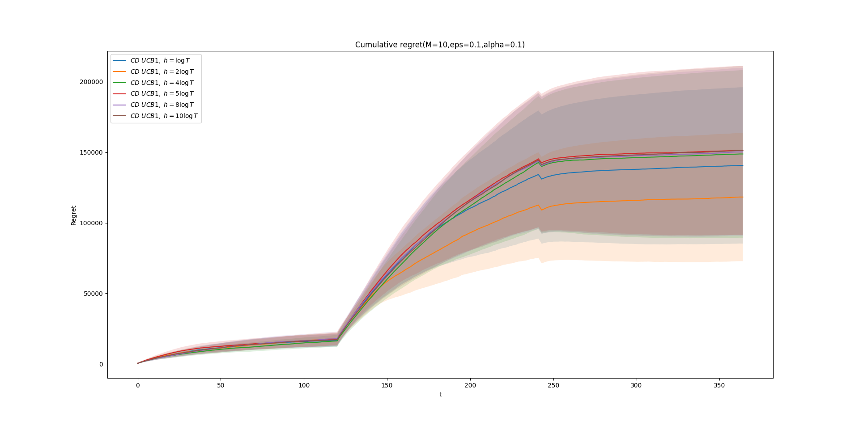
Step 5: Analysis of h
We tested different factors multiplying logT: 1,2,4,5,8,10
smaller values of the threshold achieve lower regret, in particular h= 2logT≃12 is the best choice.

Slide 28
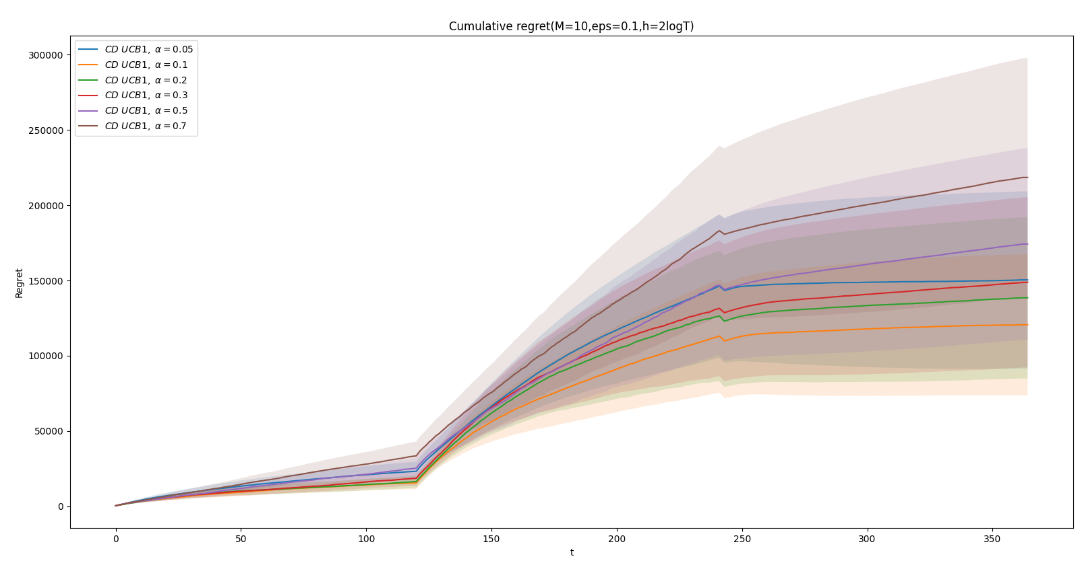
Step 5: Analysis of α
Since it’s a probability we explore six values in (0,1): 0.05,0.1,0.2,0.3,0.5,0.7
smaller values around 0.1-0.2 seem like the best choice, providing a good balance between exploration and exploitation.

Slide 29
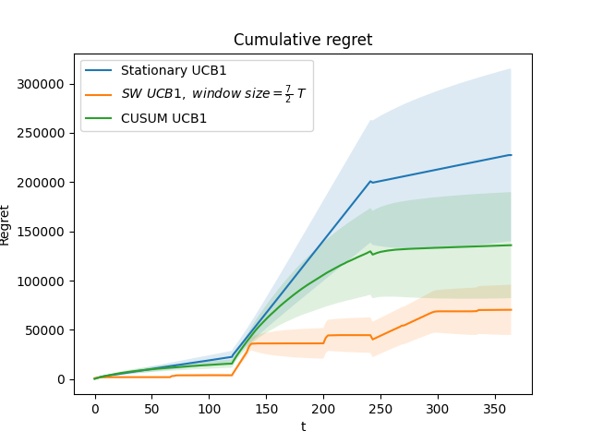
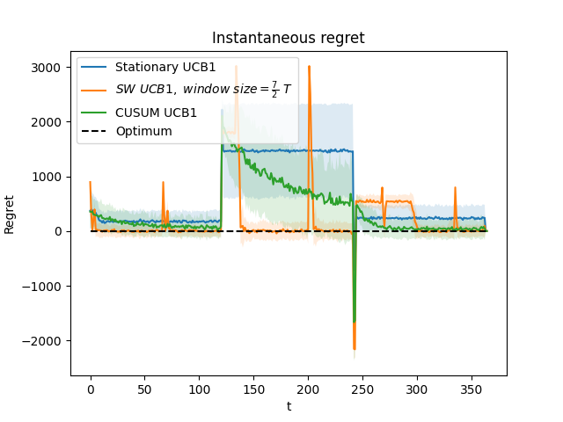
Step 5: Algorithms Comparison
We compare the performances of the three algorithms in terms of regret, taking the “best” parameters obtained before for the SW-UCB and CUSUM-UCB algorithms.

Slide 30
Step 5: Results
Sublinear regret for each of the algorithms
Worst performance is of the stationary UCB1 algorithm as expected
SW-UCB performs better than CUSUM-UCB, reacts faster after abrupt changes
Possible explanation due to the hard task of setting four parameters properly simultaneously.

Slide 31
Step 6 : Dealing with non-stationary environments with many abrupt changes
In this step we develop EXP3 algorithm, which is devoted to dealing with adversarial settings.
An adversarial setting is an environment in which we have an opponent (adversary) selecting the probability distribution of the arms in order to minimize the utility of our player.
In particular we considered 2 settings with fixed bid:
A simplified version of step 5 (3 phases).
A different non-stationary setting with a higher non-stationary degree. In particular, we considered 5 different phases, each one associated with a different optimal price. These phases cyclically change with high frequency and each one of them is repeated 5 times.

Slide 32
Step 6 : EXP3 algorithm
EXP3 is based on importance-weighted sampling, whereas the other considered algorithms are based on unweighted rewards.
This algorithm in the adversarial setting provides a Ο(√(KT)) in expectation regret bound.
By adjusting the exploration parameter 𝛄 and using adaptive reward updates, the algorithm can handle non-stationary environments and improve its performance over time.
𝛄 has the following meaning:
close to 0: gives more probability according to the weights and therefore to the rewards obtained by the game
close to 1: the probability distribution over the arms tends to be uniform

Slide 33
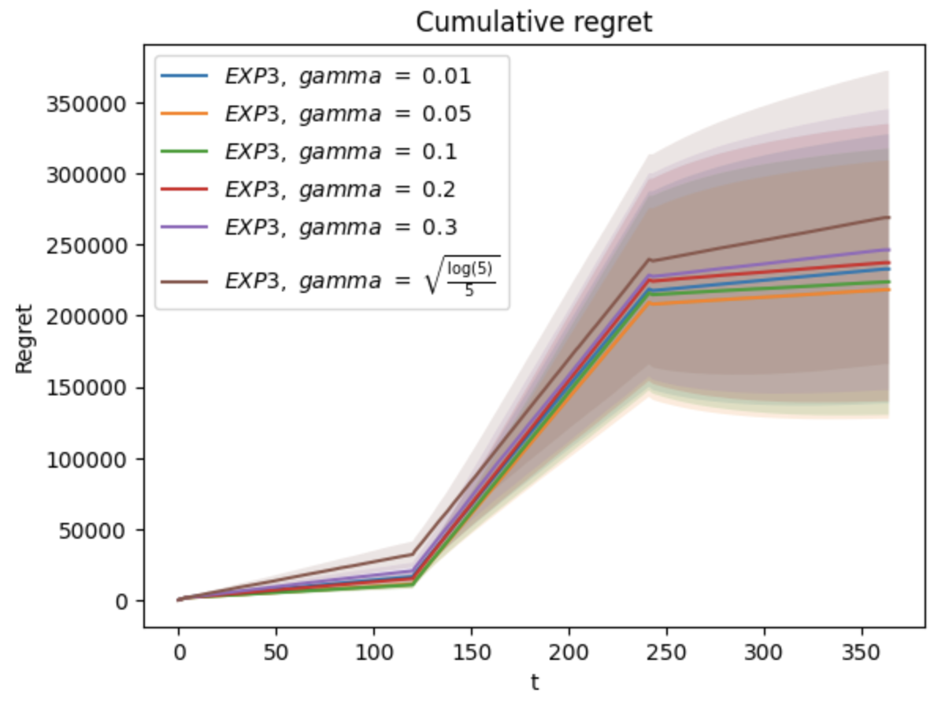
Step 6 : 𝛄 selection
After some value exploration, we decided to set constant 𝛄=0.05 which resulted to be the best performing value as can be seen in Figure.
We tested also decreasing 𝛄 with time but the obtained results were worse.

Slide 34
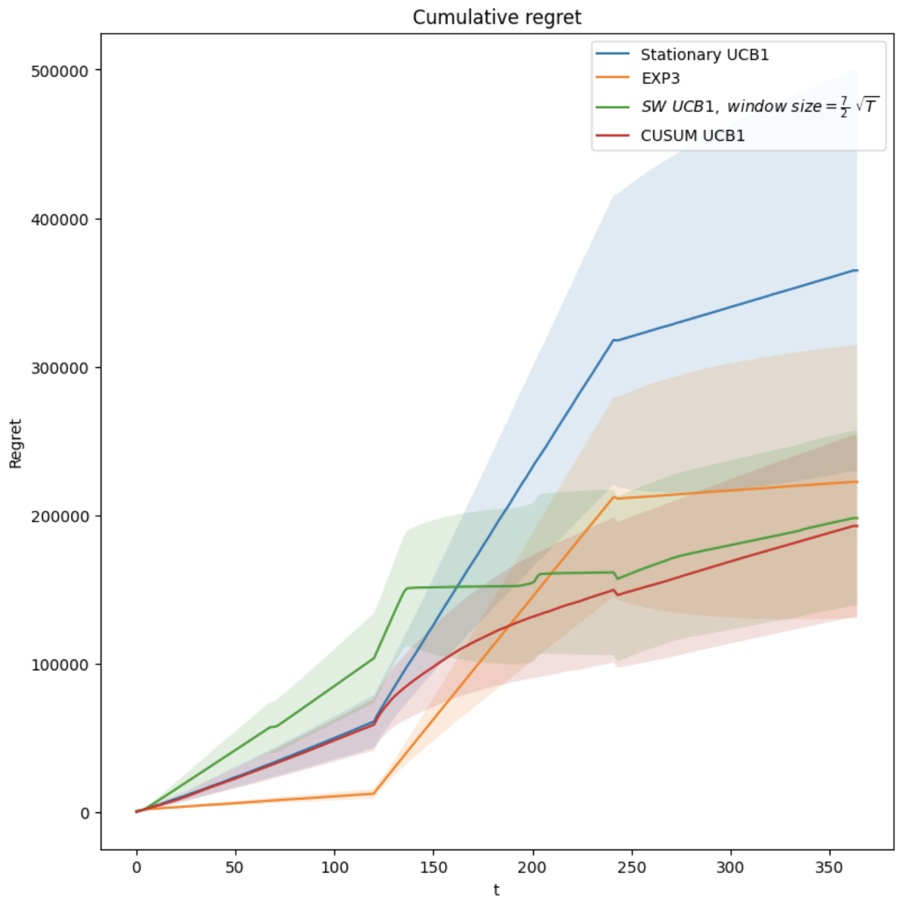
Step 6: 3 phases setting
The two non-stationary flavors of UCB1 outperform the EXP3 algorithm, which suffers from a linear regret due to its constant exploration until the end of the game.
EXP3 provides a lower cumulative regret than the stationary UCB1.
More detailed analysis and graphs can be found on the report.

Slide 35
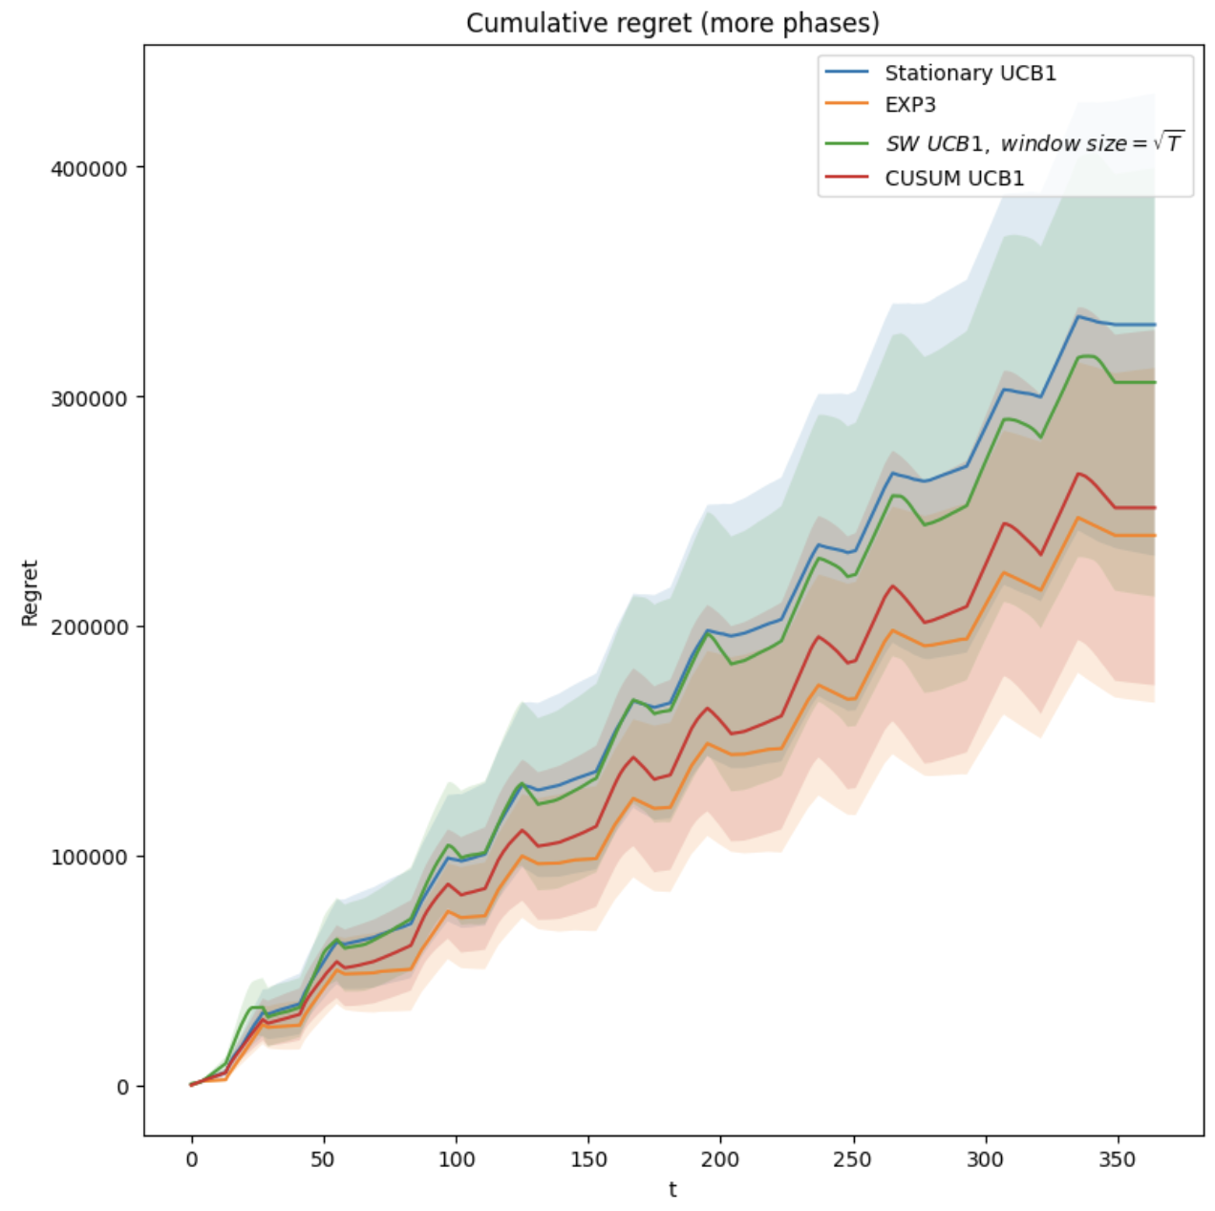
Step 6: more phases setting (1)
We decided to involve a total of 25 phases, by repeating cyclically 5 times the same phases.
In each subset of 5 phases, the first 3 have the same probability distribution of the setting with 3 phases.
EXP3 outperforms all the flavors of UCB1 and, the second best performing one is the CUSUM-UCB1 algorithm.

Slide 36
Step 6: more phases setting (2)
The EXP3 algorithm outperforms CUSUM-UCB1 due to its robustness to adversarial changes, indeed, its adaptability allows it to continue exploring new options and adapt to changes.
Moreover EXP3 is capable of adapting the learning rate, i.e., the amount of exploration and updating of action probabilities, based on the information collected over time. This allows it to balance the risk of exploring new options and exploiting high-reward options in an adversarial environment.
CUSUM-UCB1 has a fixed methodology for calculating the threshold value and detecting out-of-control values, which may not be ideal for adapting to changes and challenges present in an adversarial environment.

Slide 37
Thank you for your attention!

